Slide 1

OPEN MEETING – 21. NOV 2025

Slide 2

OPEN MEETING
INVITED PARTICIPANTS
OCR;
WMPC Representative;
CSC Members;
Chief of Missions, Team leaders, Parachute Experts from the Nations and from the Factories, Sponsors;
Guests.

Slide 3
OPEN MEETING
AGENDA
CISM Sport Committee (CSC) Members;
Calendar – Presentation(s);
Athlete of the Year;
Regulations;
Female Sport;
Communication;
Other Topics.

Slide 4
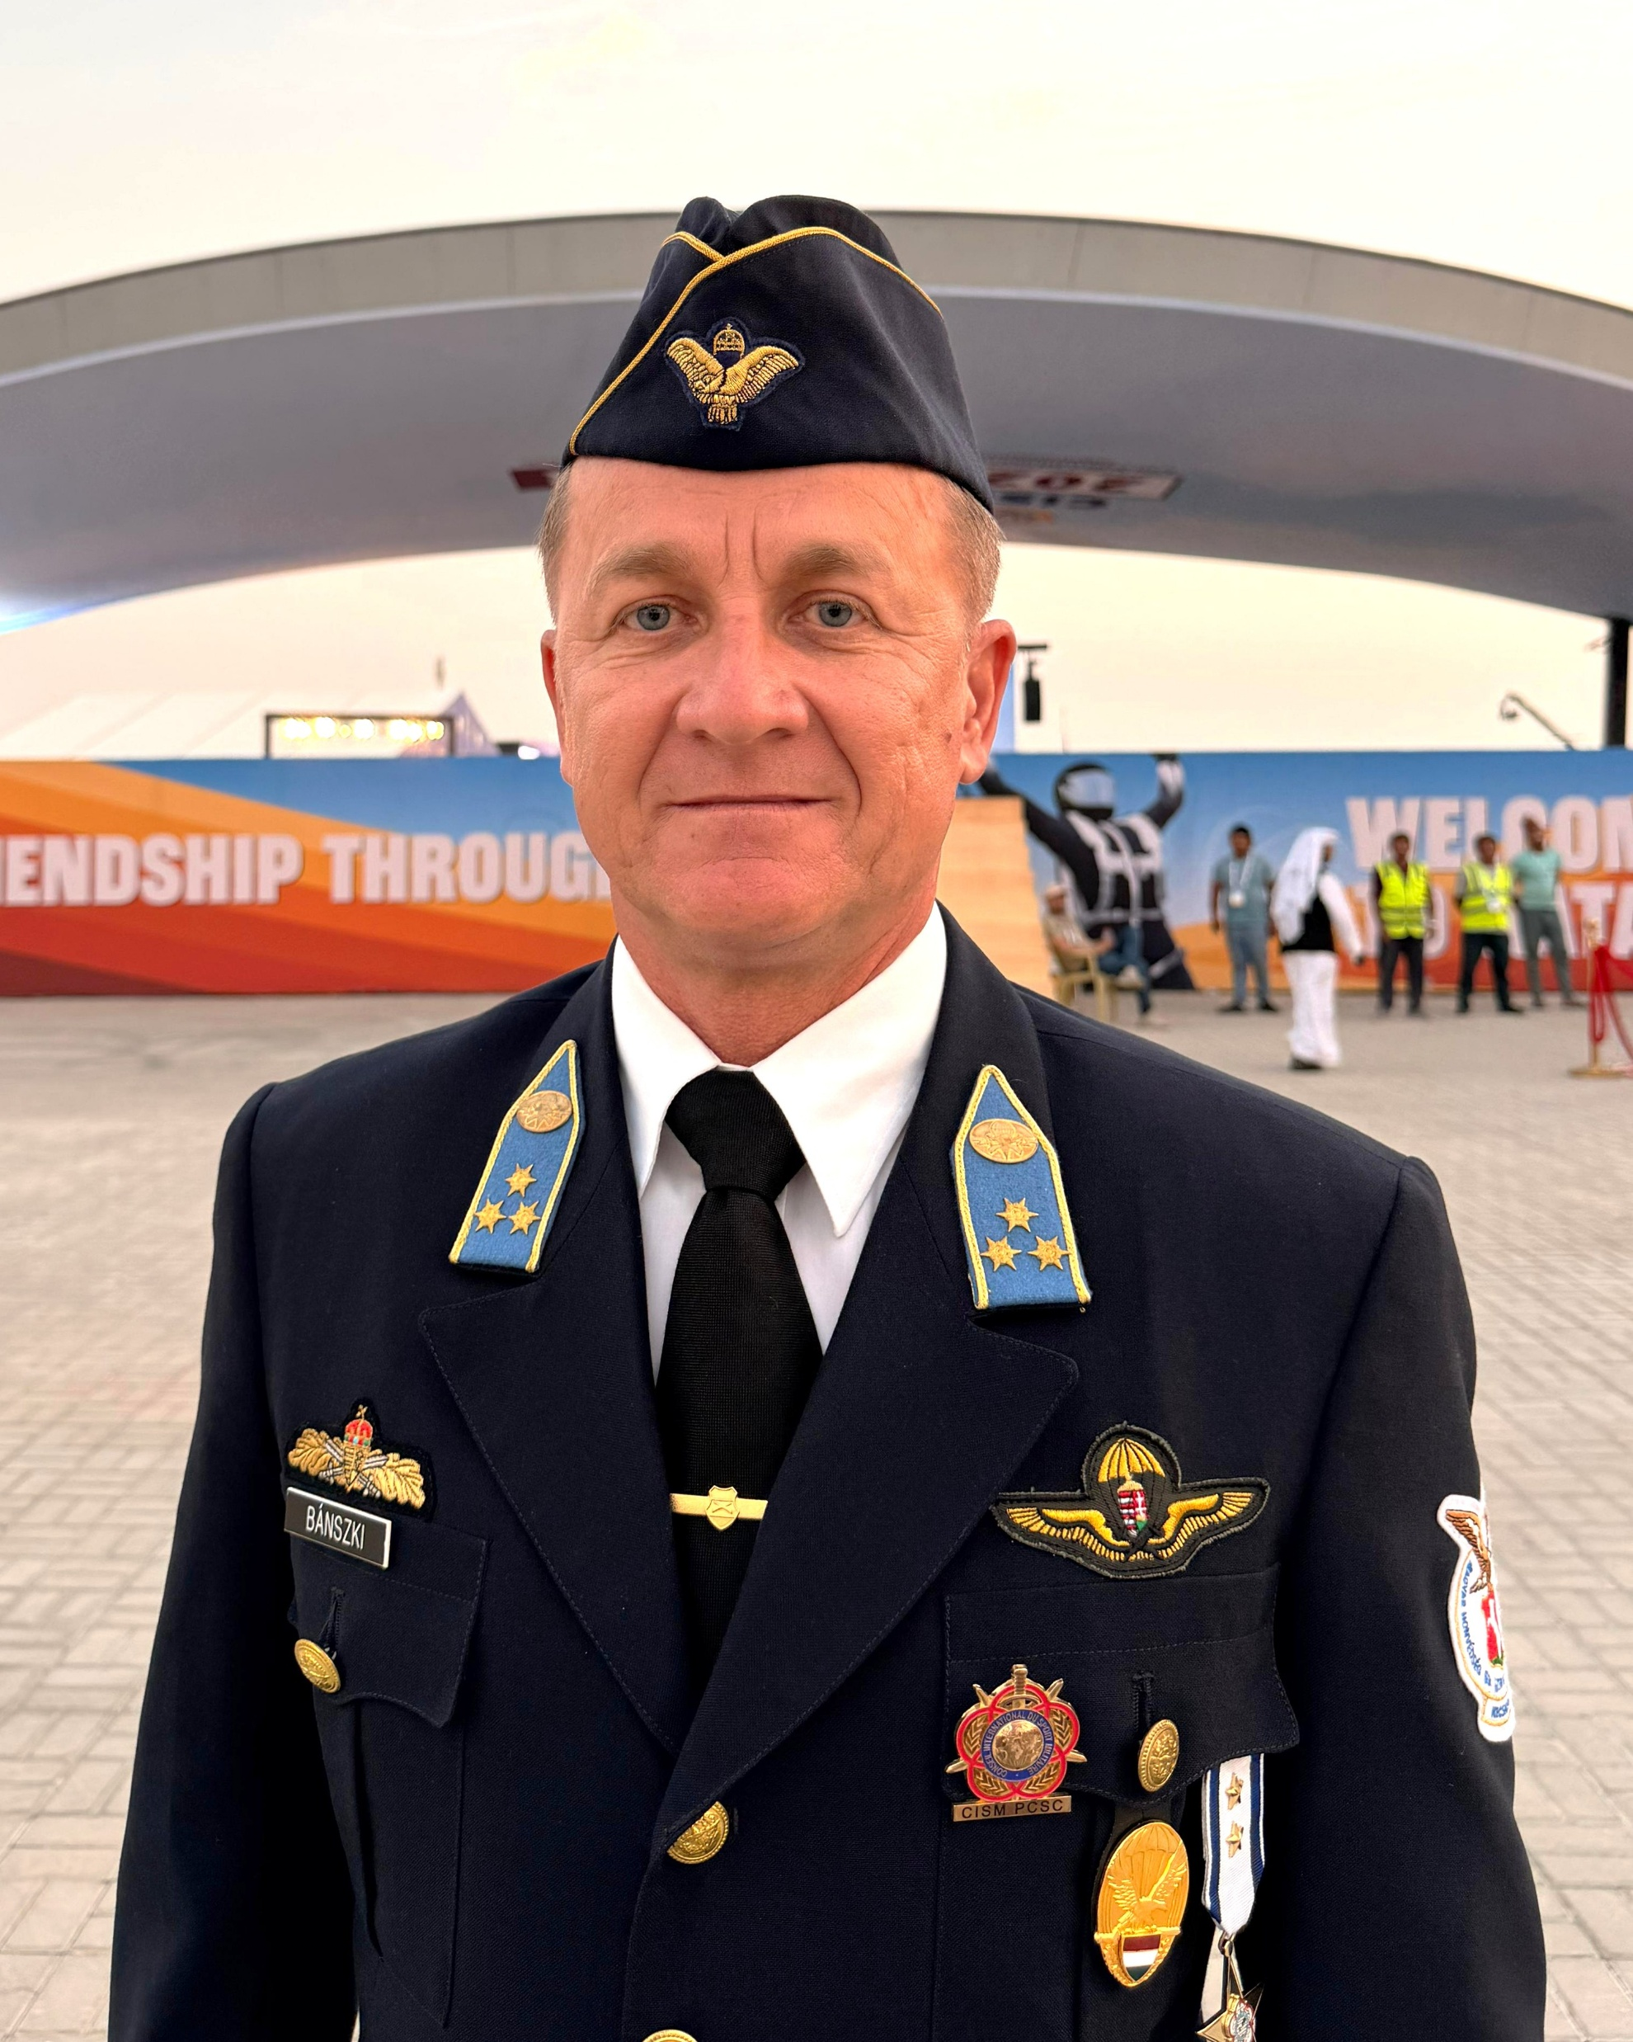

1. Composition of the CSC
Captain Tamas BANSZKI
PCSC Parachuting
parachuting@milsport.one
+36304075573

Slide 5
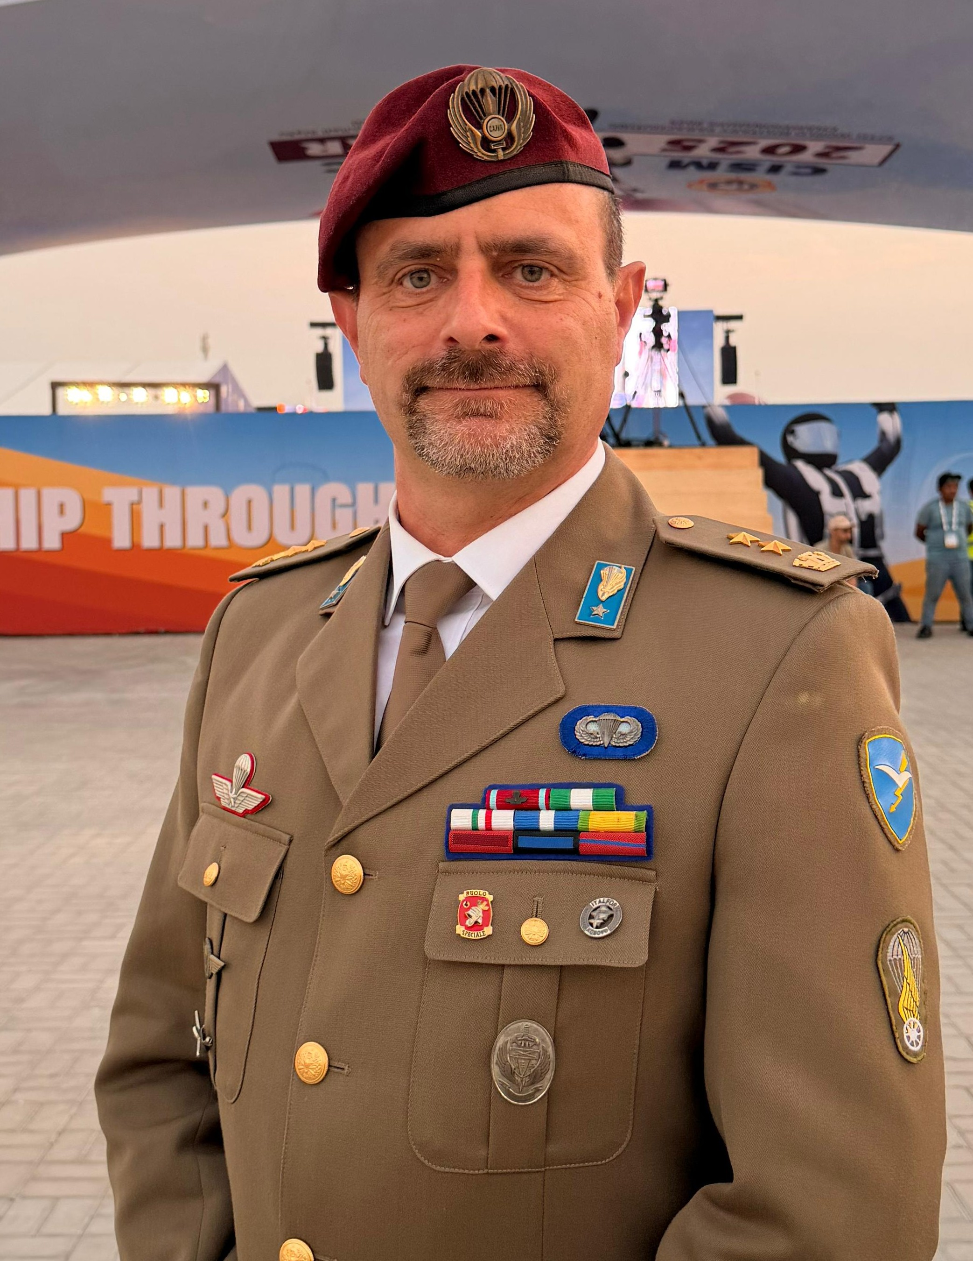
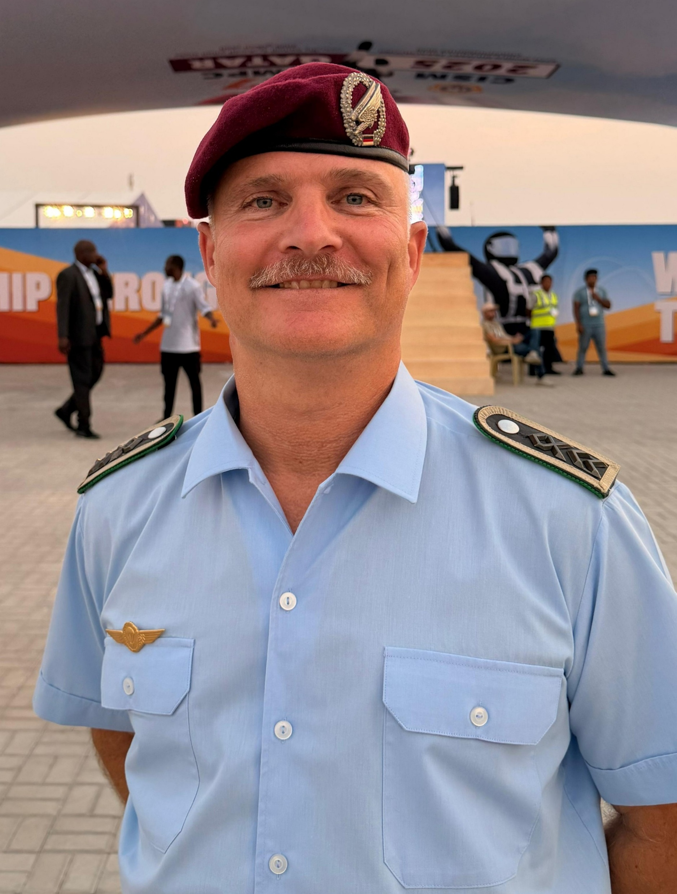
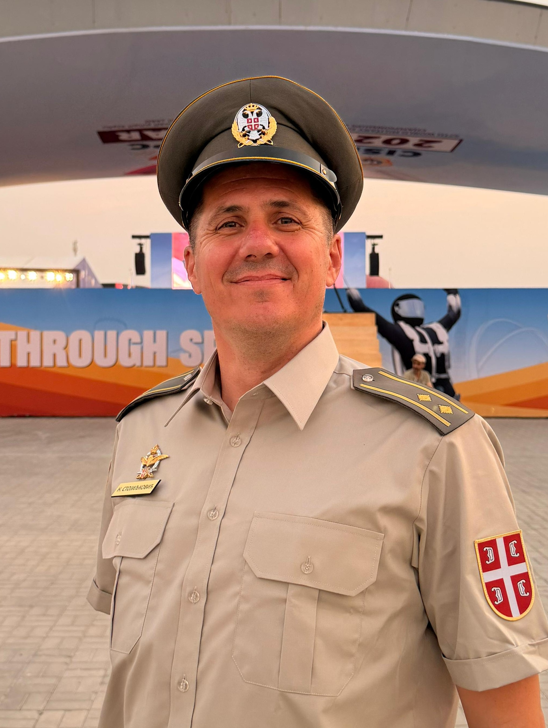
1. Composition of the CSC
Secretary-Rules
Chief Judge
Chief Judge Assistant
Lt. Col. Roberto PAGNI
S. Wo. Oliver VENT
Lt. Col. Nenad STOJILJKOVIC

Slide 6
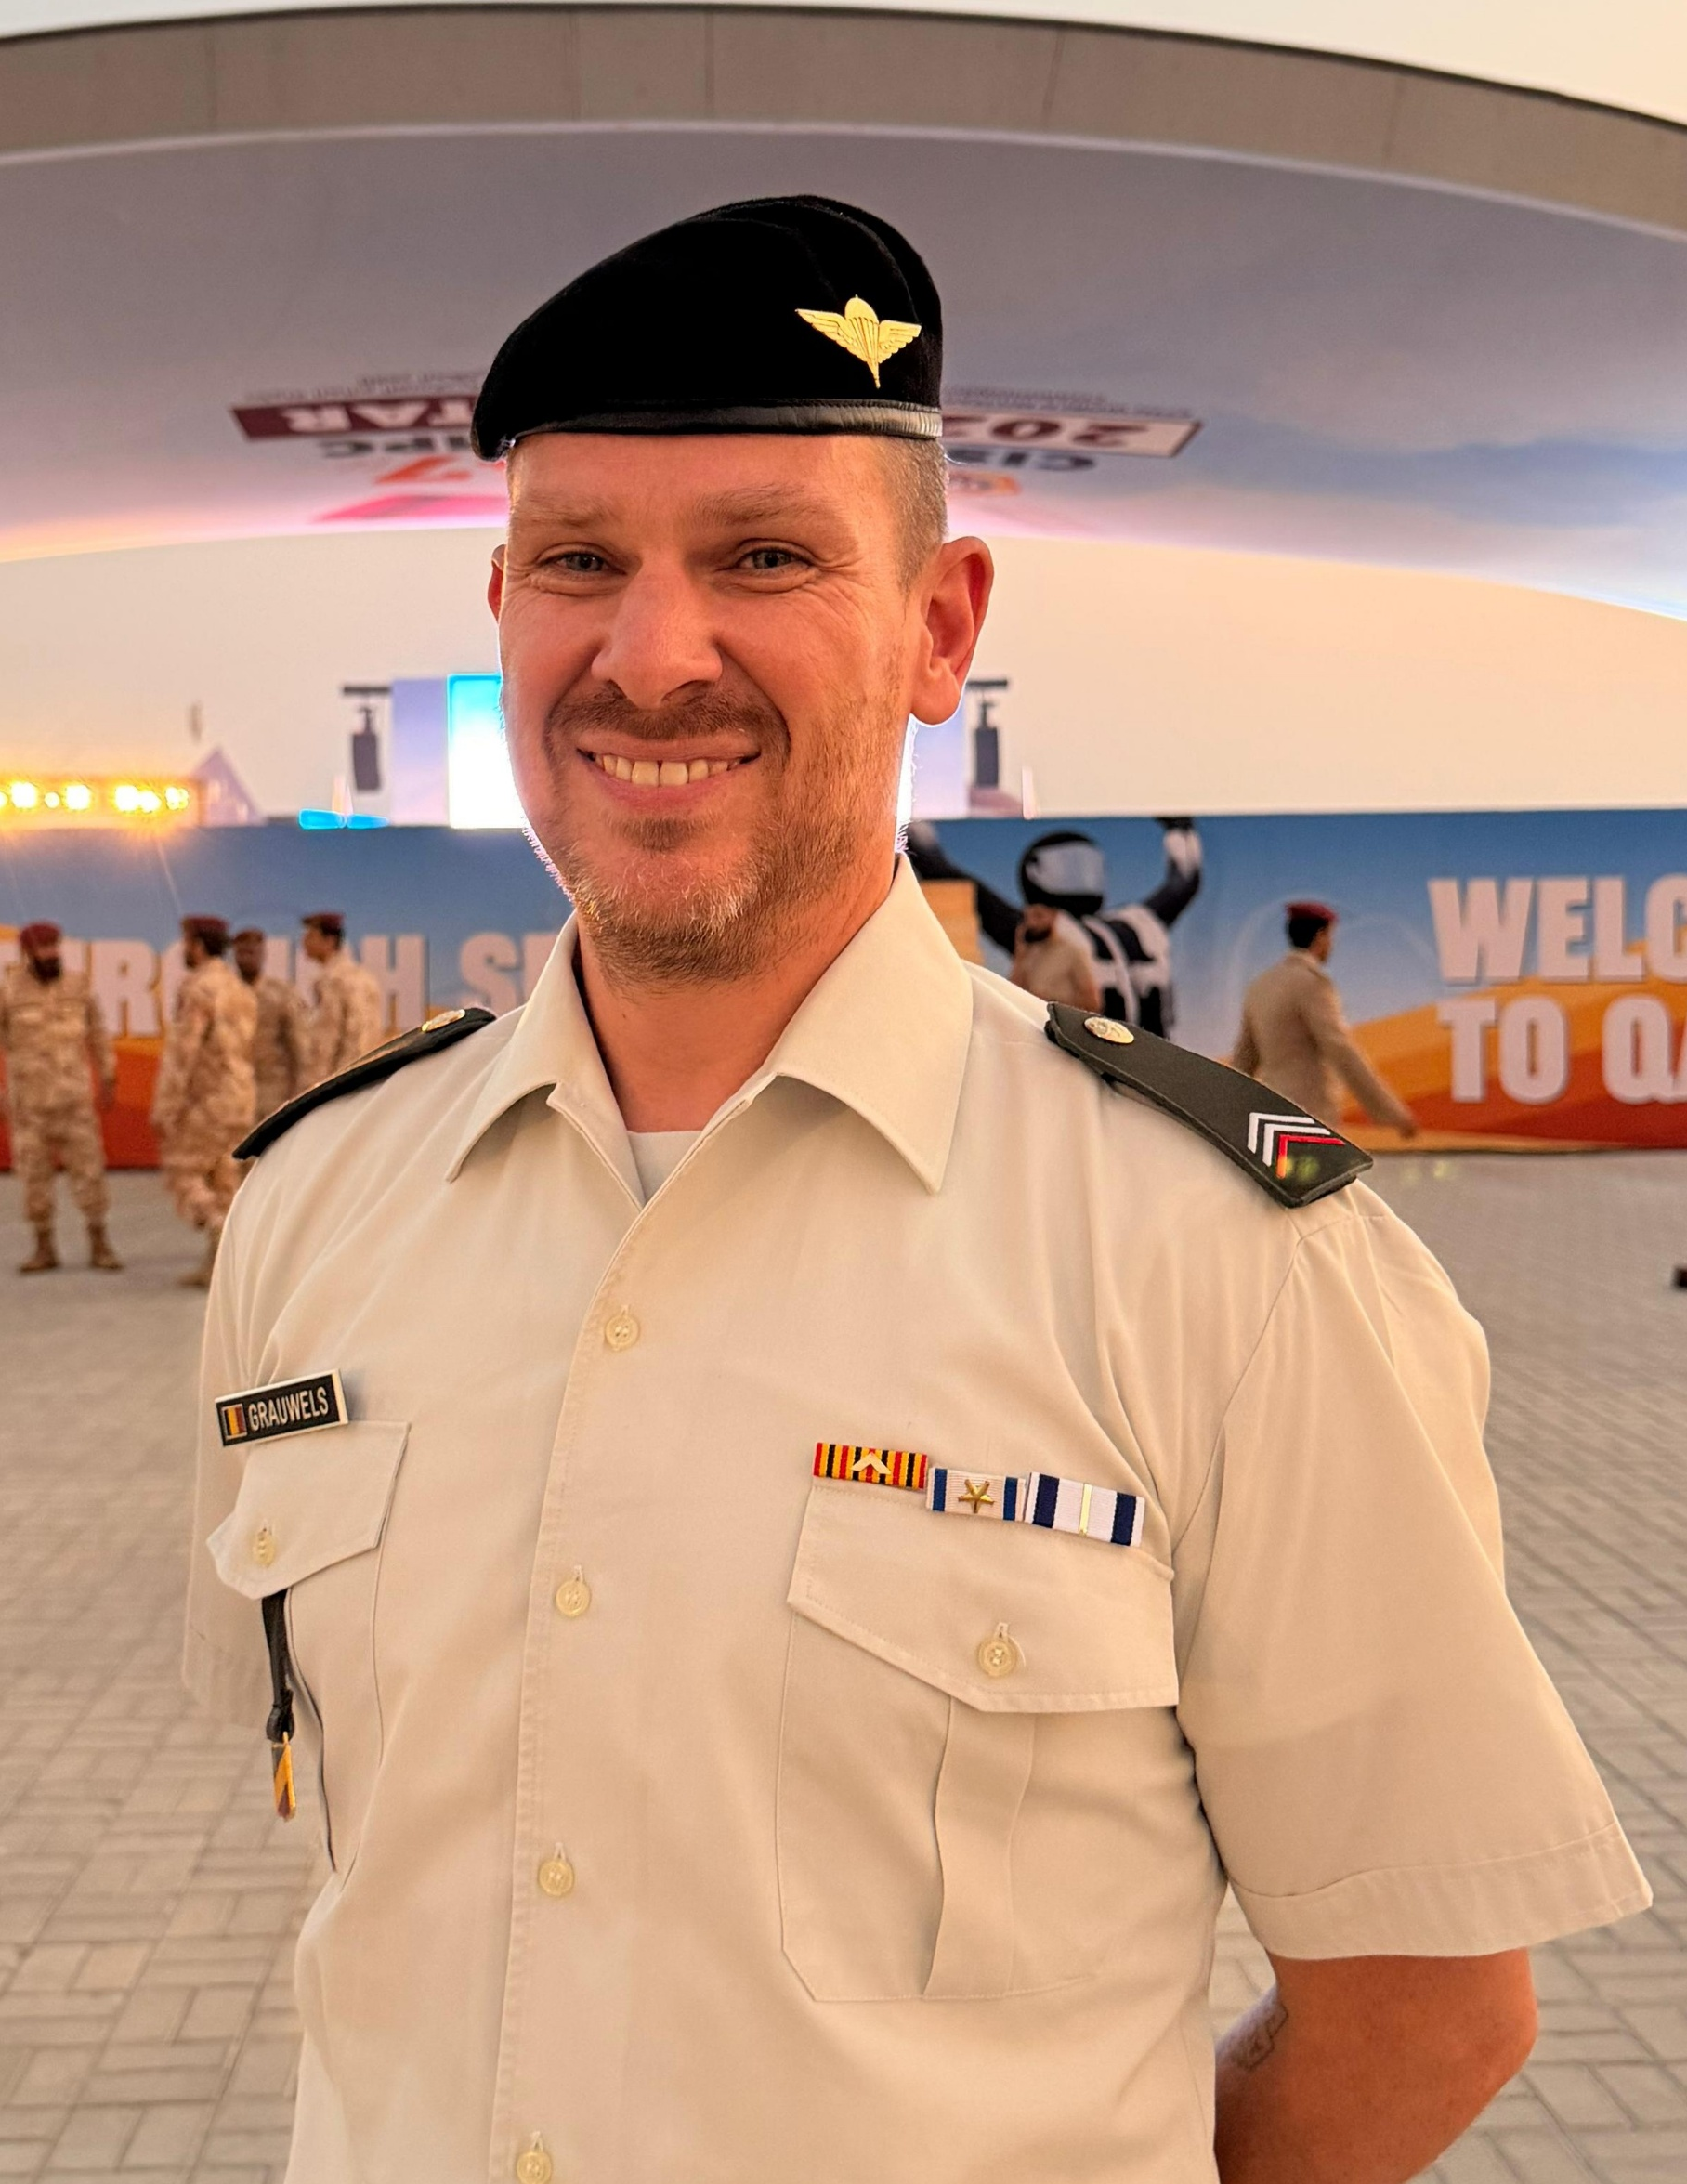
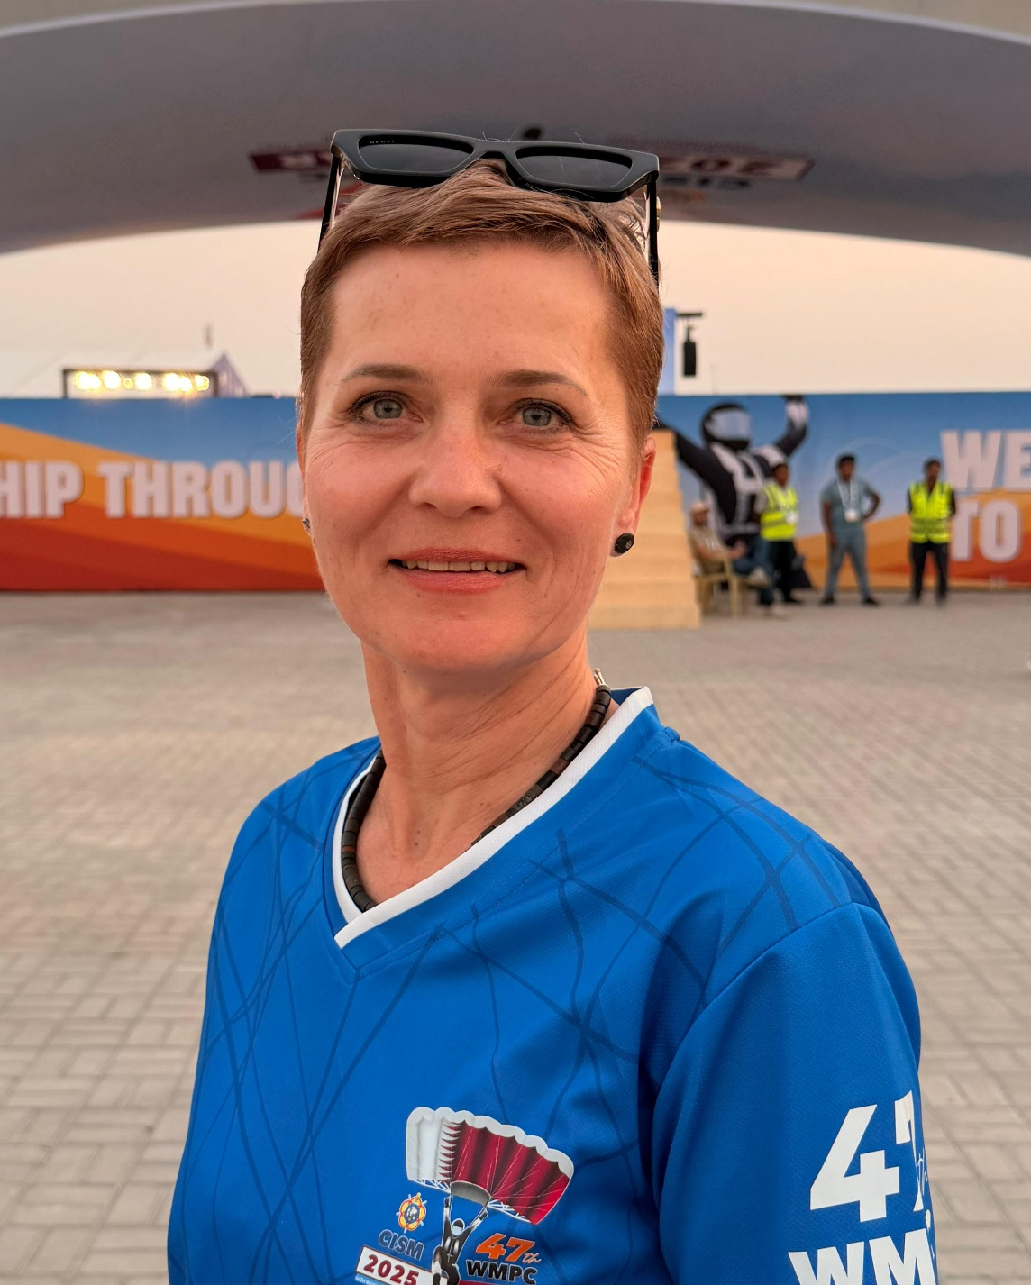
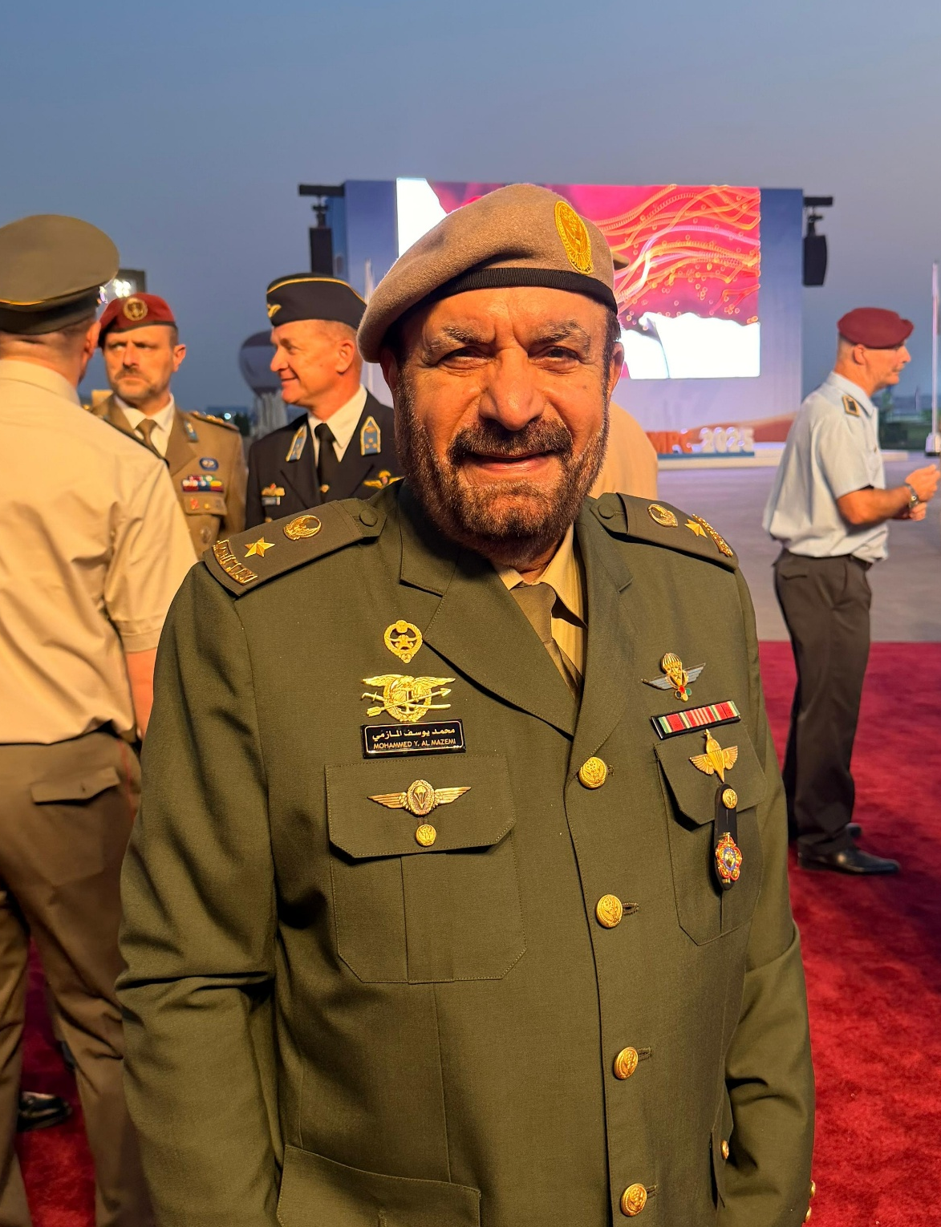
1. Composition of the CSC
Liaison ISC & Athletes
Female Sport
Liaison Middle East
S. Cpl. David GRAUWELS
Ms. Jurate VERSTREPEN
Lt. Col. (ret.) Mohammed YOUSUF

Slide 7
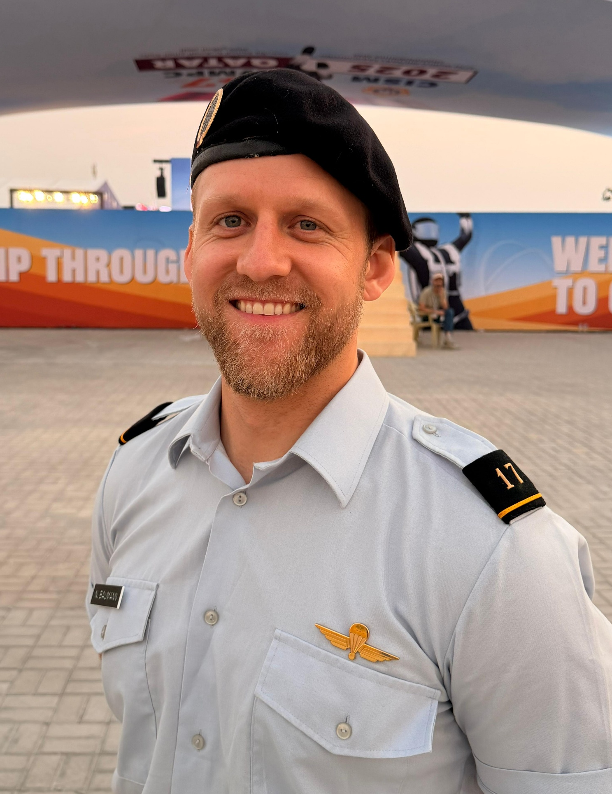
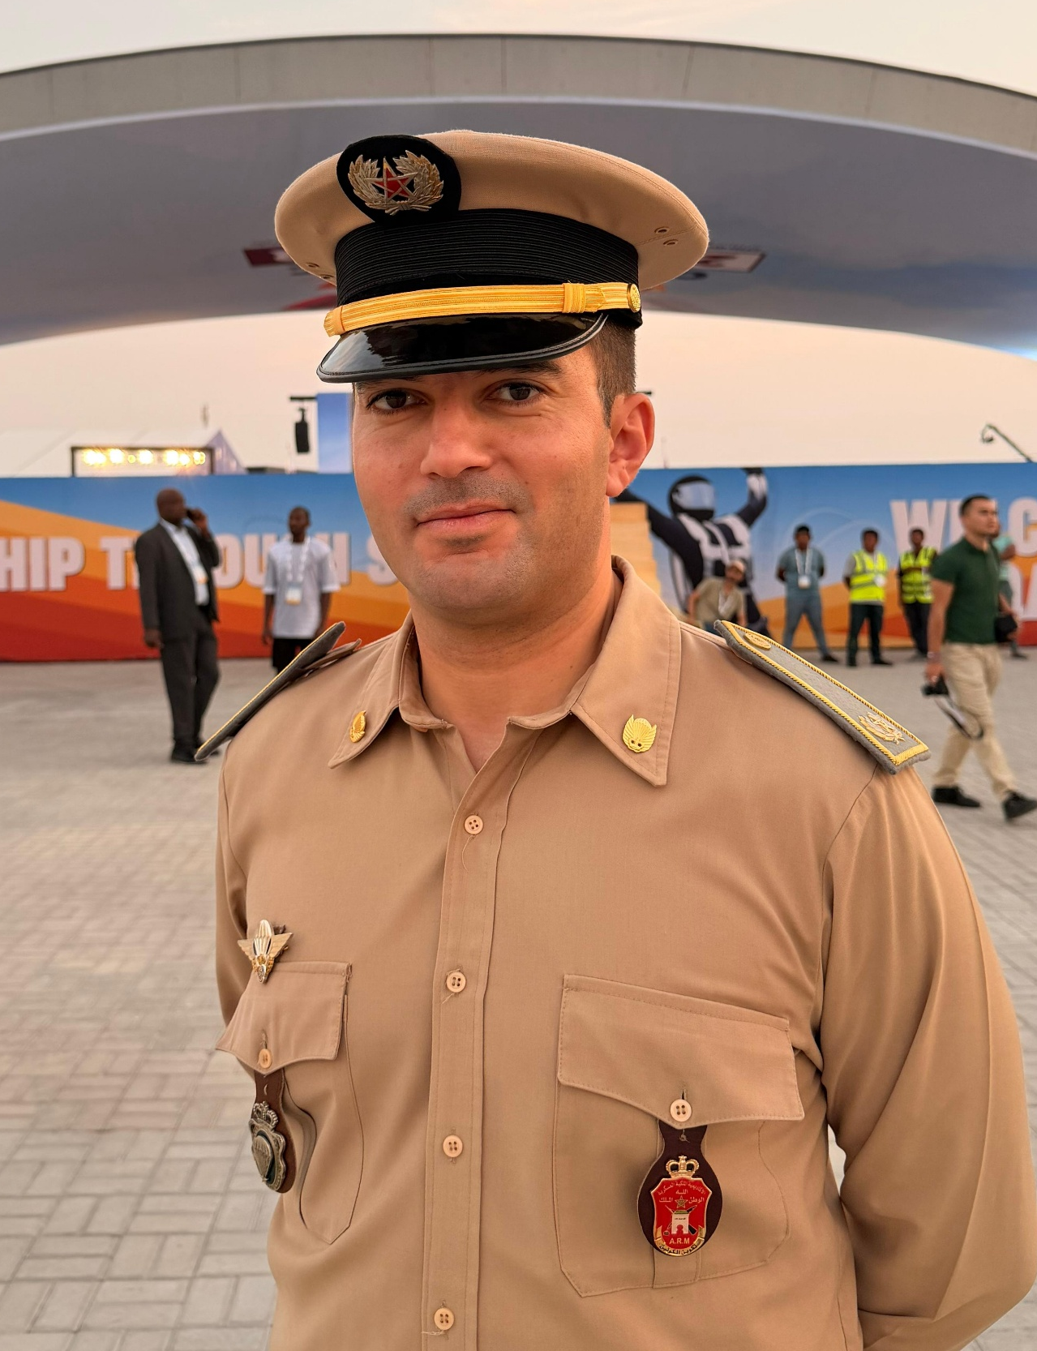
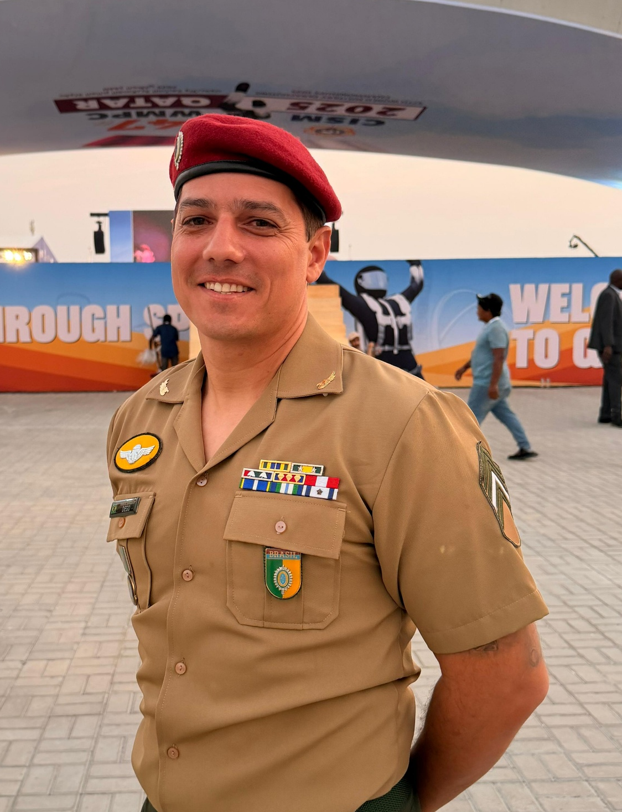
1. Composition of the CSC
Liaison Europe
Liaison Africa
Liaison America
Lt. Nicholas BAUMANN
Maj. Kamal TIGHAZRATI
Sgt. Diego SCHWEICKARDT

Slide 8
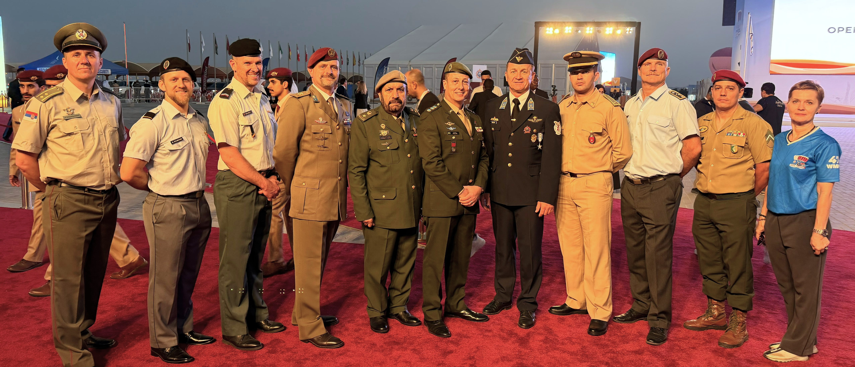
1. Composition of the CSC

Slide 9
2. Calendar
2nd Military World Winter Games
Date & Place: 23. March 2025 - Lucerne (Switzerland)
Discipline: Parachute-Ski
Participants: 32 Athletes (28 male & 4 female)
Nations: 7 Nations
Program: 2 Rounds of Ski Race &
8 Rounds of Accuracy
Result → Big Success

Slide 10
2. Calendar
Judges Seminar in Pisa (Italy)
28th April – 9th May 2025
Thanks to:
- Italian Delegation as the Host Nation
- Lt. Col Roberto PAGNI
- Sgt. Matteo ARANGINO
- Instructor Mr Jurate VERSTREPEN
- Instructor Lt. Col. Nenad STOJILJKOVIC
Result:
- 23 new qualified judges
- 5 refresher
There is a possible judges seminar planned in Türkiye or Danmark?

Slide 11
2. Calendar
The upcoming Future
WMPC 5 year plan:
2026: SVK - 48th WMPC 14-23. Aug (Lt. Lucia Vlcakova)
2027: USA – 8th World Military Games (49th WMPC) 25 June – 4 July
2028: ……………………….
2029: QTR – 9th World Military Games (51st WMPC) DOHA TBD
2030: ……………………….
Possible Organizer:
Please ask your CISM Delegation to confirm with CPC or CISM GS
Standard procedure: official form to be signed two years prior to WMPC
Emergency procedure: -“- (minimum 10 months)

Slide 12



3. Athlete of the Year
AoY = individual overall champion
Nation of winner submit CV and pix NLT 30 Nov to:
parachuting@milsport.one
Online voting at www.milsport.one Dec 2025 – Jan 2026
all please vote.

Slide 13
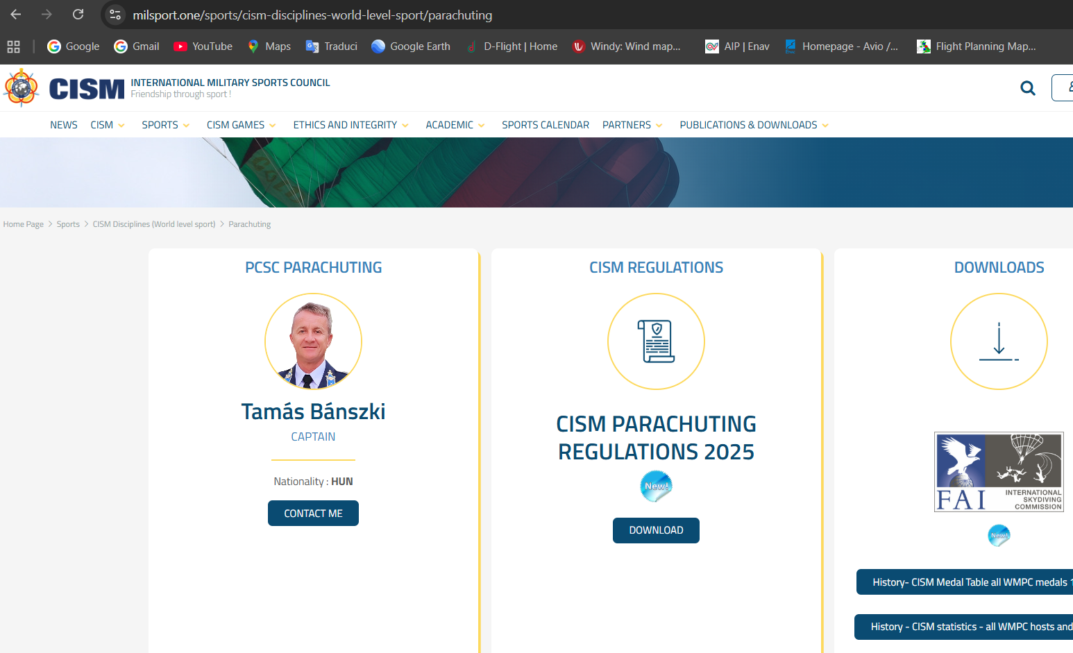
4. Regulations (1)
WHERE ?
Write «cism parachuting»
on Google;
- Login not necessary.

Slide 14
4. Regulations (2)
WHEN ? NEW EDITION - NLT JANUARY 1
WHO ? Lt. Col. Roberto Pagni (ITA)
(in coordination with other CSC Members)
roberto.pagni@esercito.difesa.it
rob.pagni@gmail.com
(Please write me to both the addresses,
sometime the military firewall reject foreign emails)

Slide 15
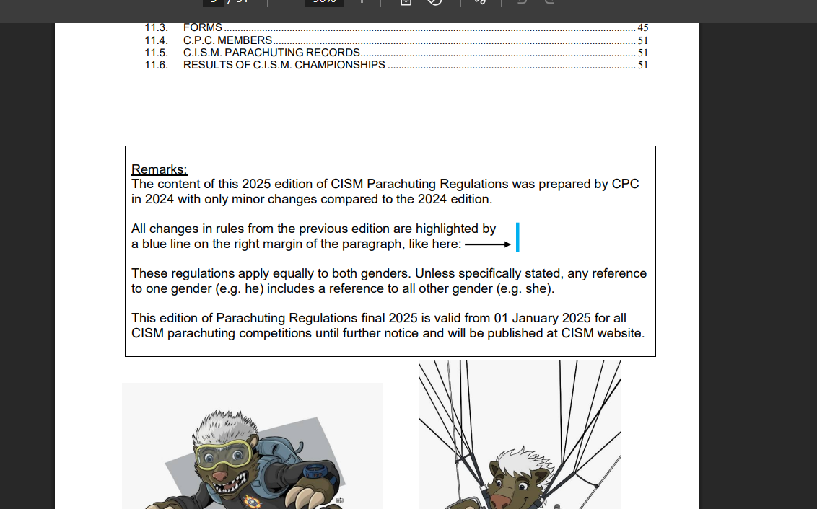
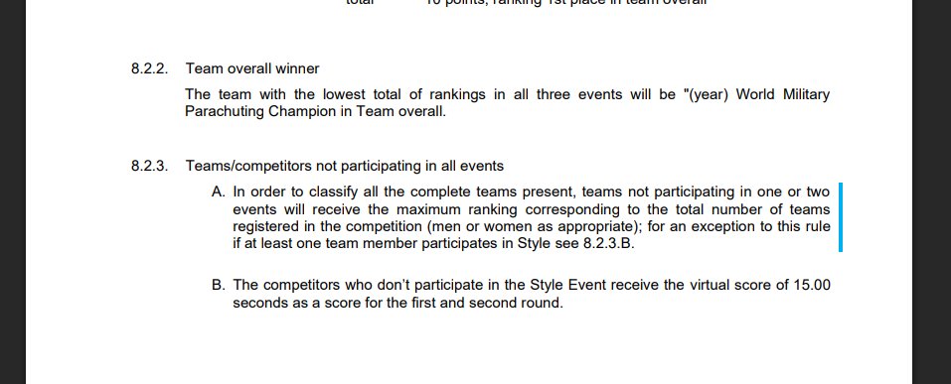
4. Regulations (3)
NEW RULES: blue line
(FROM THE LATEST EDITION)
REMARK:
Sometimes we find typos or sentences that are not clear
and we correct them. In these cases there is no blue line
because no rule has been changed.

Slide 16
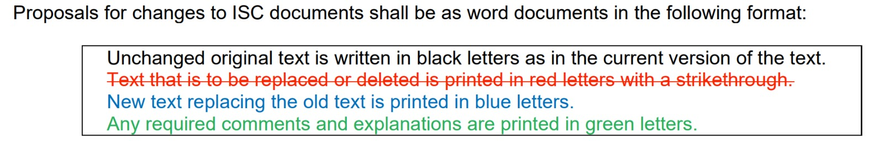
4. Regulations (4)
How to change CISM Parachuting Regulation ?
Submit the proposal to a CSC Member or to PCSC;
write down what you want to change and why,
using the same format as ISC:

Slide 17
4. Regulations (5)
At the moment work on going on some rules (virtual score on
style / cuts between rounds / number of mixed / records / ……)
but today we don’t have time to go into more detail;
Please refer to me directly for typos and not clear sentences;
If anyone wants to propose any changes, please write
immediately, because in a few days we will be in December.

Slide 18
4. Regulations (6)
Concluding… I would like to thank, in front of all of You,
the others CSC Members, all of whom are more expert than me and who always help me in this task.

Slide 19
Changes in CISM Rules 2026
Style rules 8.2.3.A and 8.2.3.B regarding virtual score of 15.00
We will delete the virtual score of 15.00 seconds.
We would like to encourage more style jumpers to participate.
But please do not use this possibility to do a fun or freestyle jump!
Notes:
Additional of this, with introduction of the 2025 new (and good) rule that those teams without participation in an event will receive a penalty of the maximum ranking and not the next free one as it was before, the previous bonus of 15 sec for not participating became obsolete.
A clear CPC choice is needed about what is the desired outcome of this rule. While 15 or 20 years ago there were too many participants and the first round of Style took almost one day, nowadays the goal may be to increase the number of participants and so the bonus should be removed. So if every team member not jumping Style receives 16,0 there is no risk to try and after two rounds the cut is applied anyhow.

Slide 20
Changes in CISM Rules 2026
Accuracy rule 5.1.4.C, - 4th round cuts
We will delete the 4th round cuts in Accuracy.
We do not save a lot of competition time by excluding inexperienced teams.

Slide 21
Changes in CISM Rules 2026
FS rule 7.1.2. FS Program - Access to 5th round
We will delete the 4th round cuts in FS.
We do not save a lot of competition time by excluding inexperienced teams.

Slide 22
Changes in CISM Rules 2026
Order of jumping in Accuracy 4.2.5.E pertaining to mixed teams.
We will bring into the rules that Mixed teams will consist of “not more than four (4) jumpers".
Due to safety reasons!

Slide 23
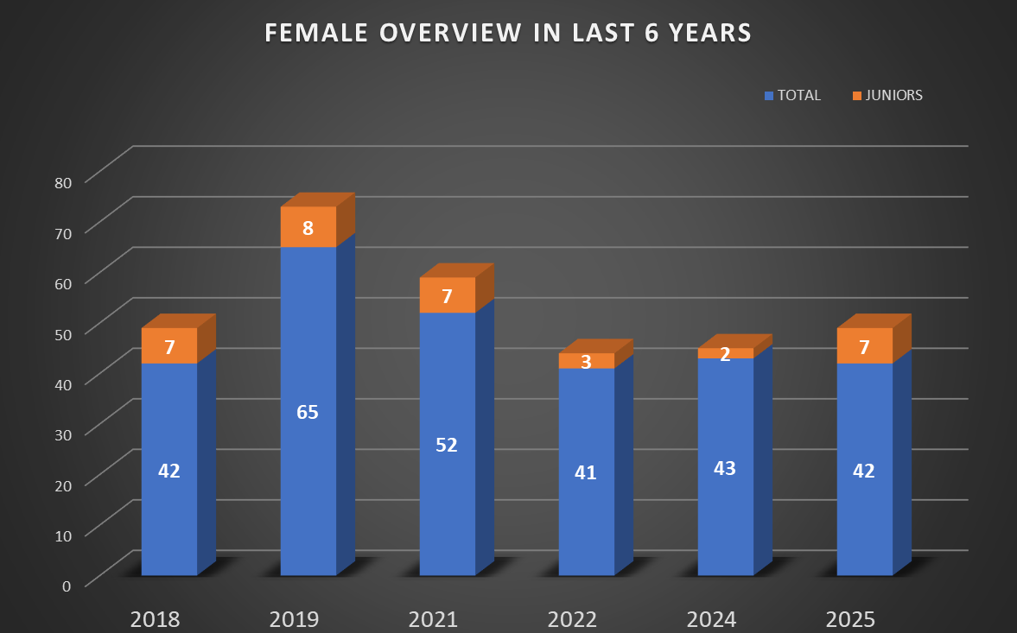
5. Female sport
Ms Jurate VERSTREPEN

Slide 24
6. Communication
Official channel:
@milsport.one
parachuting@milsport.one
+36304075573
Unofficial channel:
WhatsApp

Slide 25
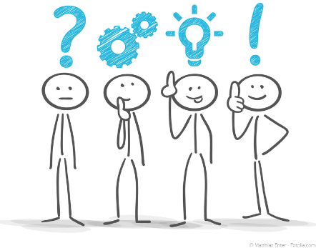
7. Questions or remarks?

